Slide 1

Gateway Claims
Vat Changes

Slide 2
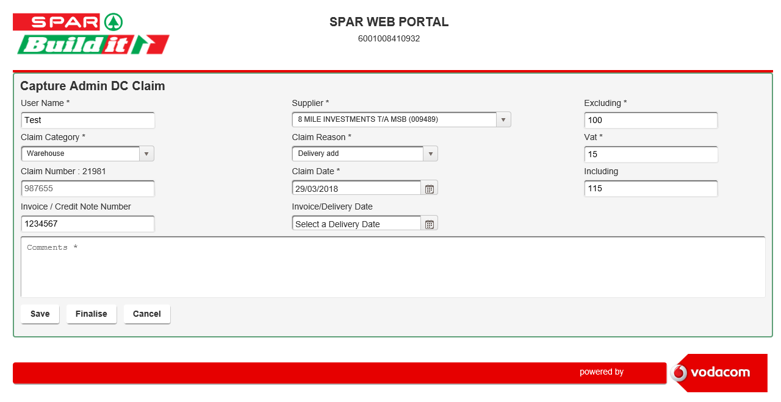

What’s changed
As of Tuesday, 2nd April, the default VAT amount auto calculated as part of the Admin DC Claims capture screen will be based on the new 15% vat rate.
As per existing functionality, this field can be overridden to cater for claims that are based on a different VAT rate.

